Slide 1
Stock Price Prediction and Portfolio Optimization Using Recurrent Neural Networks and Autoencoders
Predictive Analytics World 2020 Berlin
Julian Quernheim
Notes:
Hello everyone, my Name is Julian Quernheim.
I am working as a data science consultant for several now.
The idea for this presentation comes from the fact that I am very interested in finance topics and forecasting with deep learning methods.
Recently, I have been working among others for two asset management clients as well as as a trainer to teach Data Scientists in the autombobile industry about timeseries deep learning methods, like RNNs, Autoencoders, anomaly detection etc.

Slide 2
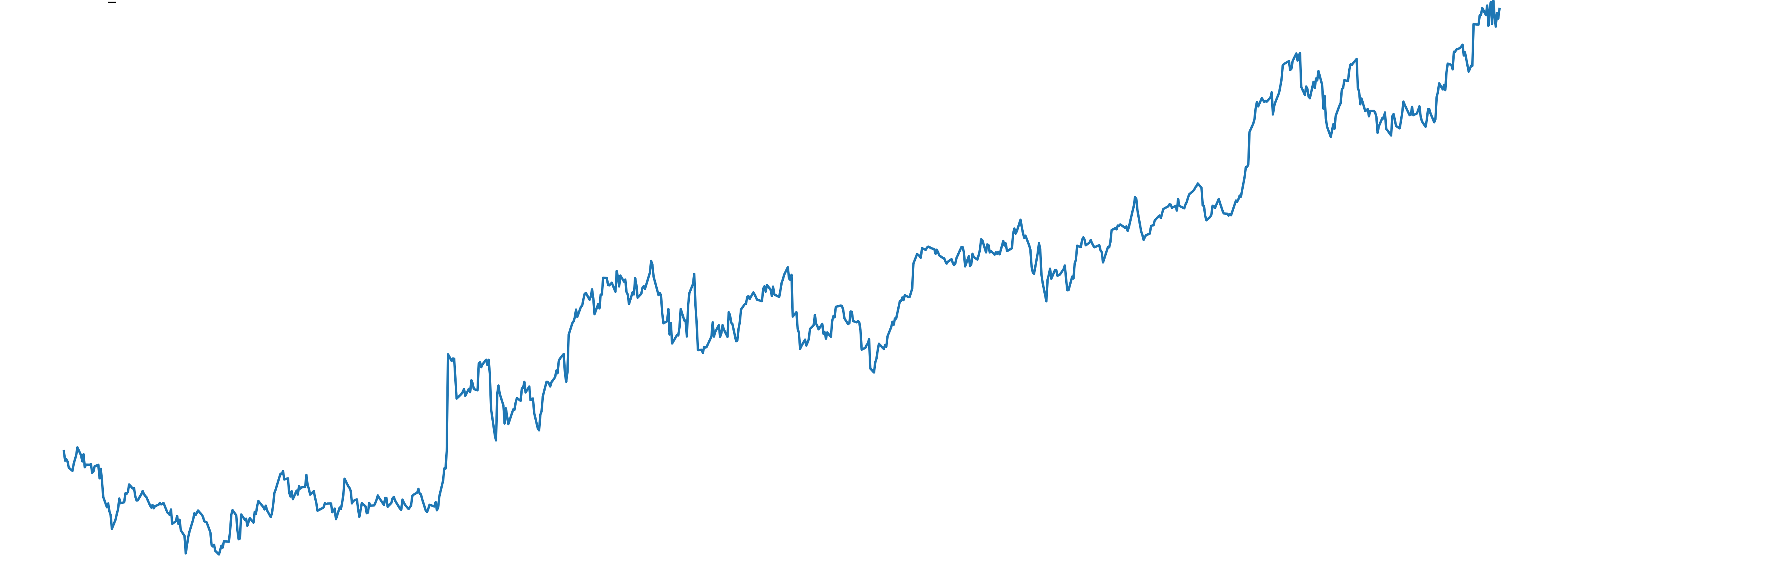
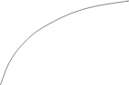
Introduction
Methods for calculating an optimal stock portfolio still focus on historic data of stock returns and additionally have difficulties capturing non-linearities of the timeseries when quantifying risk.
This talk addresses this problem using deep learning methods.
A basic knowledge of deep learning and portfolio management is required.
Notes:
Optimize the future, not the past!
Apply depp learning methods to capture non-linearity of timeseries data

Slide 3





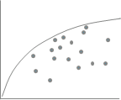

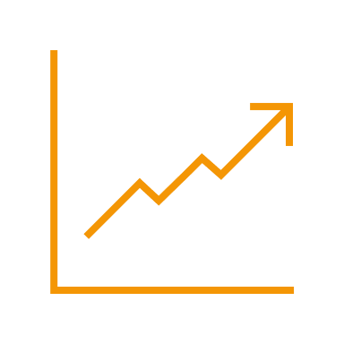
Introduction
Focus, forecast and clean.
Which stocks to analyze? Focus on stocks that move the market to decrease computation time!
Does forecasting improve the portfolio? Don’t forecast too far. A forecast is only a strong indicator.
How to improve the risk calculation of a stock? Try to capture non-linearities in the time series.
How to calculate an optimal portfolio? Don’t trust the in-sample results. Look at the out-of-sample results.

Slide 4
Literature Review

Slide 5
Literature Review
Heaton et.al
(Deep Portfolio)
Timeline of portfolio selection methods
Degree of applicability
Ledoit & Wolf, 2003
(Shrinkage)
Black-Litterman
McKibbon
and Rose
(APT)
Markowitz, Sharpe (CAPM)
Markowitz
1952
1964
1973-1976
1991
2002
2016
Timeline of portfolio selection methods
Notes:
CAPM = Capital asset pricing model (single-factor model)
The CAPM lets investors quantify the expected return on an investment given the different risks types in a linear regression model.
CAPM distinguishes between:
1. systematic (market) risk
2. unsystematic (company) risk
CAPM measures the risk of an investment in terms of its volatility compared to the market. This measure is called beta.
ABT = Arbitrage pricing theory: (single factor model)
More factors like macro economic factors, e.g inflation etc.
APT uses fewer assumptions than CAPM.
→ All models have dificulties measuring expected return and volatility !!!
Black_litterman model: → find a first solution to measure expected returns by relying on priors!
- Developed by Goldman-Sachs
- Investors have to state how an investement return deviates from the maket return and how confidence the investor is in his opinion.
Shrinkage
„Honey, I shrunk the sample covariance matrix“
Tries to find a better way to measure volatility/smaple conavriance matrix using shrinkage.
Deep Portfolio
First paper that uses deep learning to create an optimal stock portfolio.
Authors try to apply autoencoders to beat the index and show promising results!

Slide 6
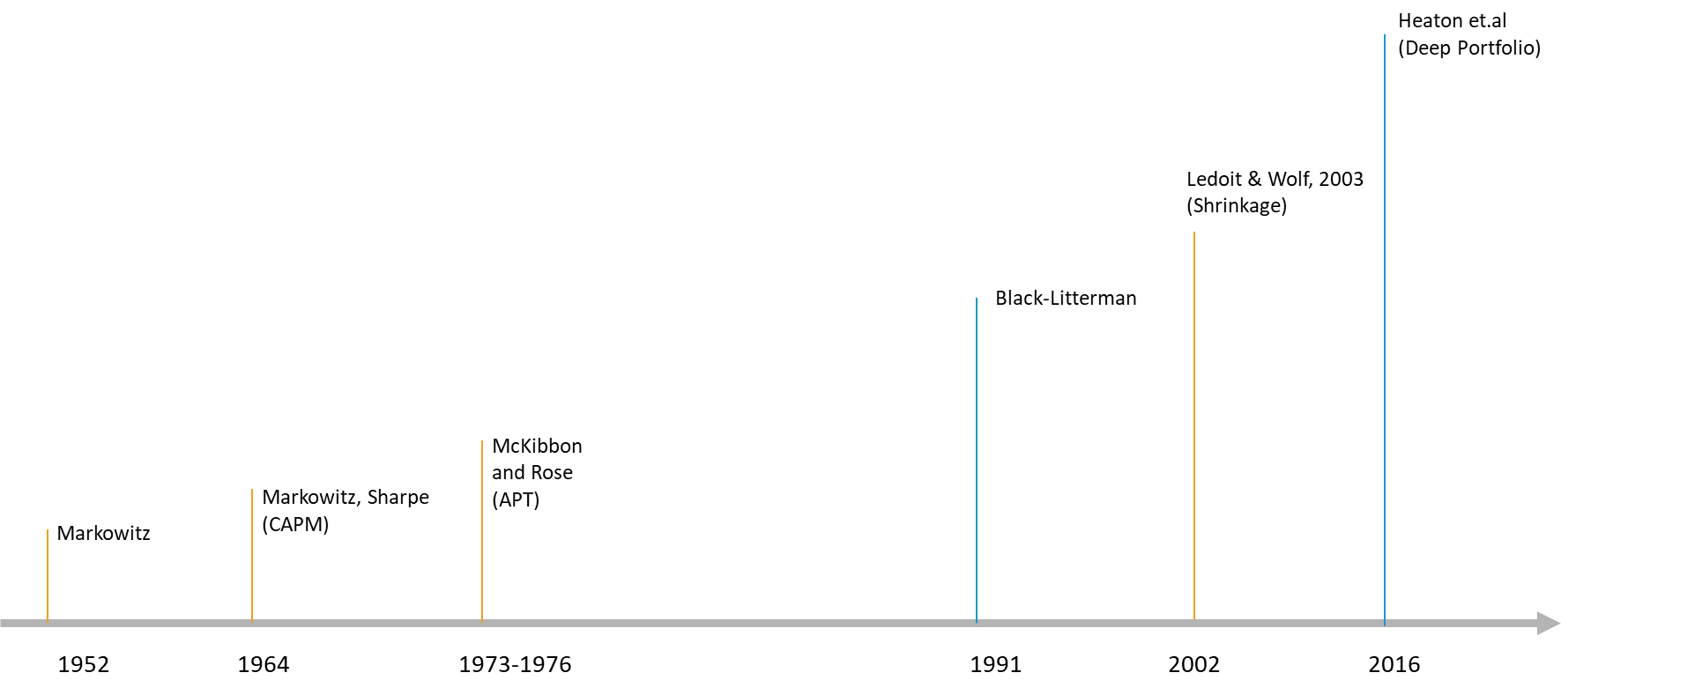
Literature Review
LSTMs
(Hochreiter, 1997)
Timeline of deep learning methods
Degree of applicability
Autoencoder
(Goodfellow et al., 2016)
Backpropagation (Werbos, 1974)
RNN
(Jordan, 1986)
BBT
(Werbos, 1990)
Timeline of deep learning methods
Notes:
ANNs became more applicable over time because training the models is now easier.
Backpropagation (Werbos)
Foundation to train ANNs
RNNs
First ANN able to process sequential data!
Timeseries forecasting is now possible with deep learning!
BTT
Training RNNs is now possible!
Trainig becomes more computational expensive the more timesteps are processed.
→Vanishing or exploding gradient problem
LSTMs
Hochreiter studied in Munich at the LMU
LSTMs cells are able to forget!
Autoencoders
Autoencoders are ANNs that attempts to recreate ist input as its output.
Autoencoders are used by Heaton in their paper on Deep portfolio.

Slide 7
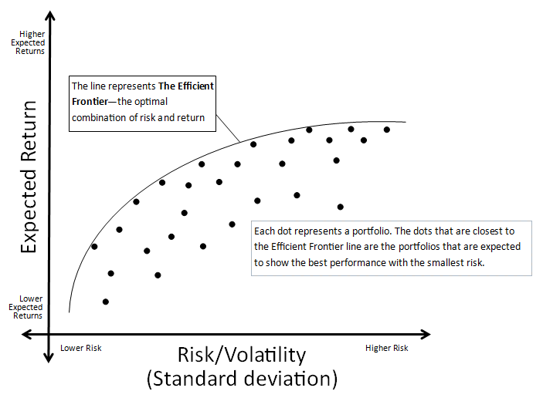
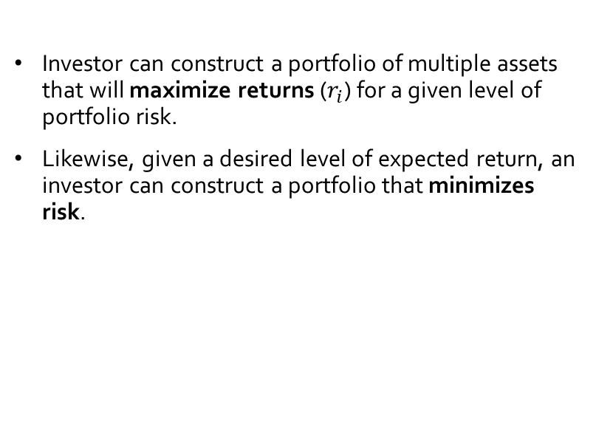
Literature Review
Modern portfolio theory (MPT) (Markowitz, 1952)
What is MPT?
Investor can construct a portfolio of multiple assets that will maximize returns ($r_{i}$) for a given level of portfolio risk.
Likewise, given a desired level of expected return, an investor can construct a portfolio that minimizes risk.
Efficient frontier: Source: http://www.alamedafinancialgroup.com/Our-Investment-Phiosophy.5.htm

Slide 8
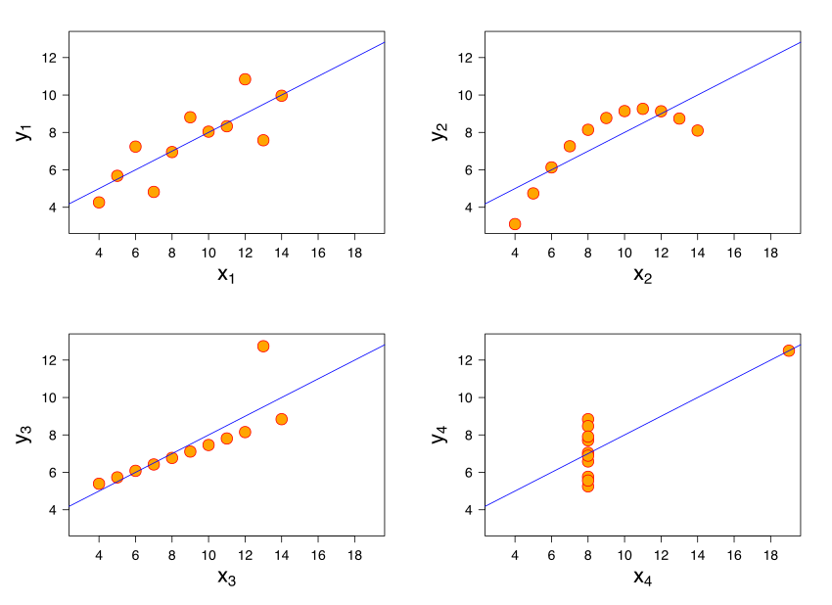
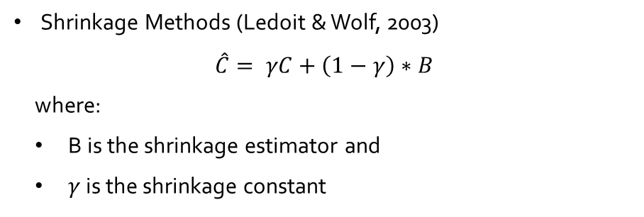
Literature Review
Modern portfolio theory (MPT) (Markowitz, 1952)
Pitfalls of covariance
The covariance indicates a linear relationship between two variables. Hence it can be fallacious in situations where two variables have a relationship, but it is nonlinear.
Covariance is strongly influenced by outliers.
Solutions
Shrinkage Methods (Ledoit & Wolf, 2003)
$$\hat{C}= γC+\left(1−γ\right)∗B$$
where:
B is the shrinkage estimator and
$γ$ is the shrinkage constant
Anscombe's quartet: All four sets are identical when examined using simple summary statistics but vary considerably when graphed.
Notes:
All 4 graphs show the same correlation between different timersies!
Bottom right → outlier
Bottom left → linear
Top → 3rd and 2nd order polynomial
→ Shrinkage is one methods to deal with cleaning/adjusting the sample covariance matrix.

Slide 9

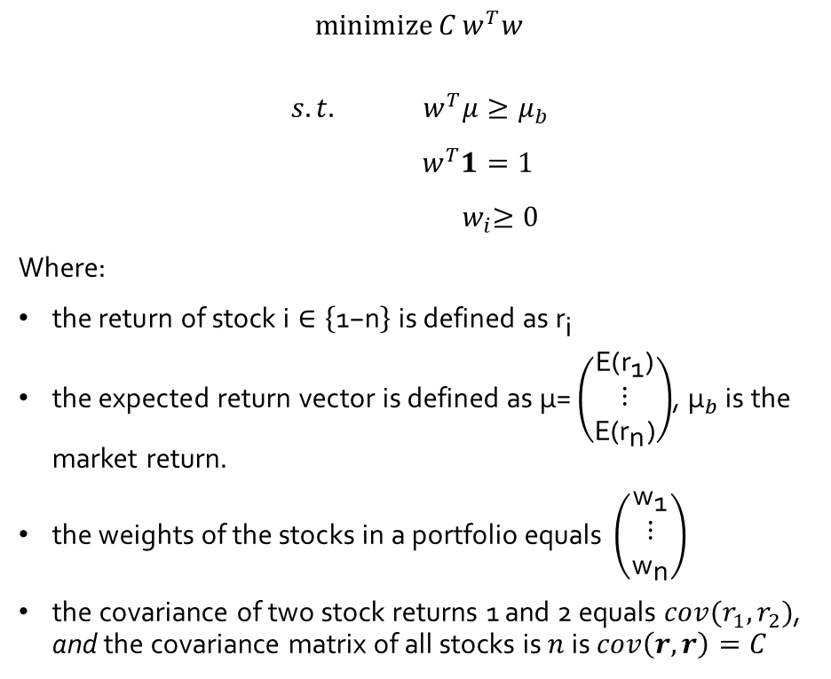
Literature Review
Modern portfolio theory (MPT) (Markowitz, 1952)
Linear programming formulation
$$\operatorname{minimize}{C}w^{T}w$$
$$s.t.{ w}^{T}μ≥μ_{b}$$
$$w^{T}1=1$$
$${ w}_{i}≥0$$
Where:
$\text{the} \text{return} \text{of} \text{stock} \text{i}∈\left\{\text{1−}\text{n}\right\} \text{is} \text{defined} \text{as}{ \text{r}}_{\text{i}}$
$\text{the} \text{expected} \text{return} \text{vector} \text{is} \text{defined} \text{as} \text{μ}\text{=}\left(\begin{matrix}\text{E}\text{(}{\text{r}}_{\text{1}}\text{)} \\ \text{⋮} \\ \text{E}\text{(}{\text{r}}_{\text{n}}\text{)}\end{matrix}\right)$, ${\text{μ}}_{b}$ is the market return.
$\text{the} \text{weights} \text{of} \text{the} \text{stocks} \text{in} \text{a} \text{portfolio} \text{equals} \left(\begin{matrix}{\text{w}}_{\text{1}} \\ \text{⋮} \\ {\text{w}}_{\text{n}}\end{matrix}\right)$
the covariance of two stock returns 1 and 2 equals $cov(r_{1},r_{2})$, and the covariance matrix of all stocks is $n$ is $cov\left(r,r\right)=C$
Source: https://medium.com/datadriveninvestor/simple-portfolio-optimization-harry-markowitz-mean-variance-model-using-excel-part-1-efc3f19a347

Slide 10
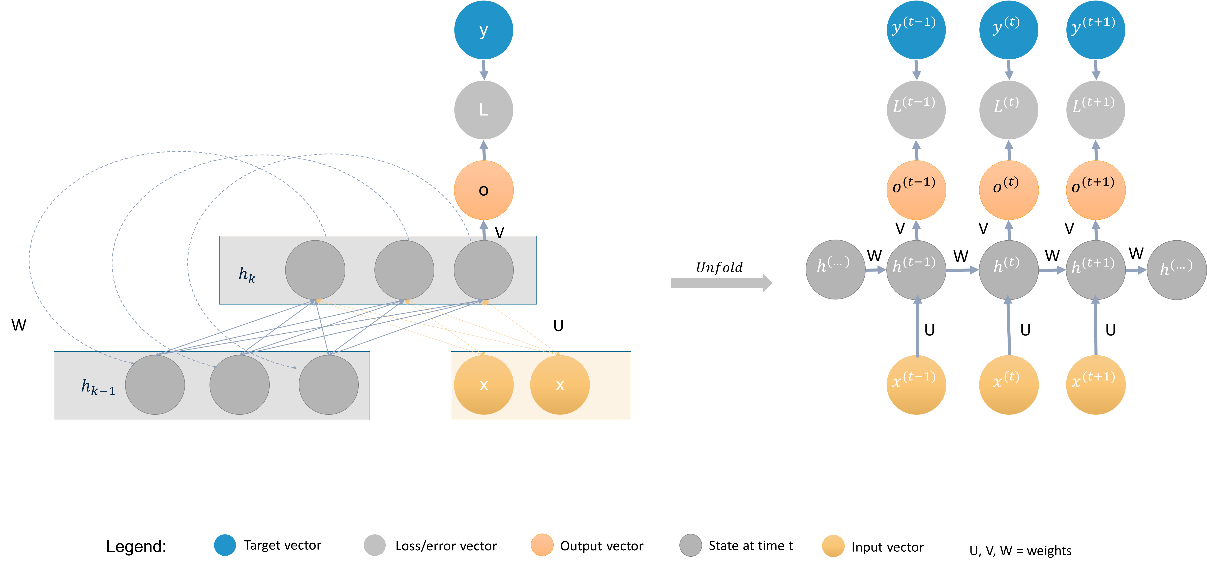
Literature Review
How do Recurrent neural networks work?
Recurrent neural networks (RNNs) process sequential data.
Each state of the RNN is therefore a function depending on its previous states.
An example of a folded and unfolded RNN.

Slide 11
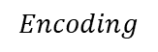
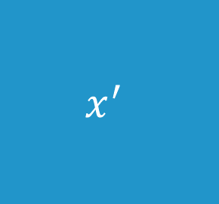
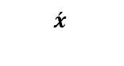
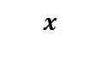

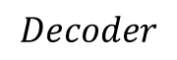
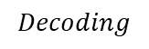
Literature Review
What are Autoencoders?
$$x$$
z
$$\acute{x}$$
An autoencoder is an unsupervised neural network that is trained to attempt to copy its input to its output [Goodfellow et al., 2016].
Autoencoders are used for:
dimensionality reduction
removing structural noise
feature learning
outlier detection
Input Cells
Hidden Cells
Output Cells
$$x$$
$$Encoding$$
$$Decoding$$
Example of an undercomplete autoencoder with three input and output layers and two hidden layers.
Encoder
$$Hidden Vector$$
$$Decoder$$
x
z
$$x^{′}$$
Input Vector
Hidden Vector
Output Vector

Slide 12
Data, Methodology & Results

Slide 13
Data, Methodology & Results
Which stocks to analyze? → Apply an autoencoder model and filter stocks that can be recreated best
Does forecasting improve the portfolio? → Forecast the next 10-days of a stock closing value into the future using Recurrent Neural networks
How to improve the risk calculation of a stock? → Apply latent features of an autoencoder model to clean the sample covariance matrix
How to calculate an optimal portfolio? → Apply Markowitz portfolio optimization and find the optimal stocks for the portfolio

Slide 14
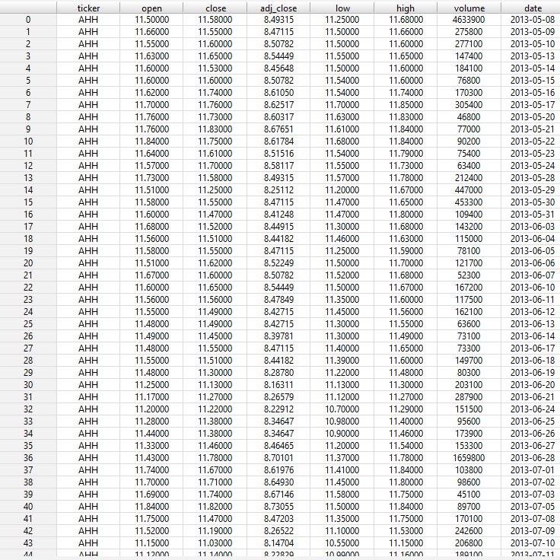
Dataset
Dataset: daily-historical-stock-prices-1970-2018
Source: Kaggle
Stock exchanges NYSE and NASDAQ
Dataset dimension: [20973889 rows x 8 columns]
Tickers: 5685
Original stock dataset

Slide 15
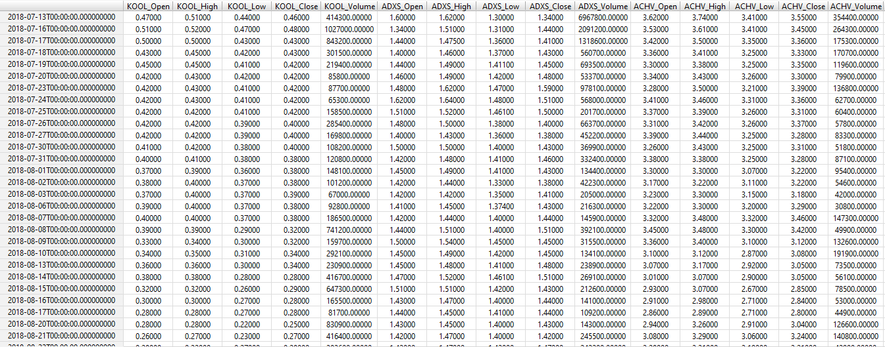
Dataset
Selected last 1000 days from 2014 -2018
Transformed each ticker into columns
Final dataset: [1000 rows x 13925 columns]
Transformed stock dataset

Slide 16
Which stocks to analyze?
1
Focus on stocks that move the market!
Stocks
Latent features
Stocks
s1
…
S_n
t1
0.3
0.2
0.1
0.1
0.3
0.2
0.4
0.1
-2
0.3
0.4
Intuition:
The stocks with the lowest recreation error (L2-norm) represent the market better. They are less volatile and are considered to be similar to large cap stocks.
Returns
0.1
Returns
Input Cells
Hidden Cells
Output Cells
t_n
Top 500
Calculate L2-Norm and select best recreated stocks
Autoencoder model with ranked recreation error.

Slide 17
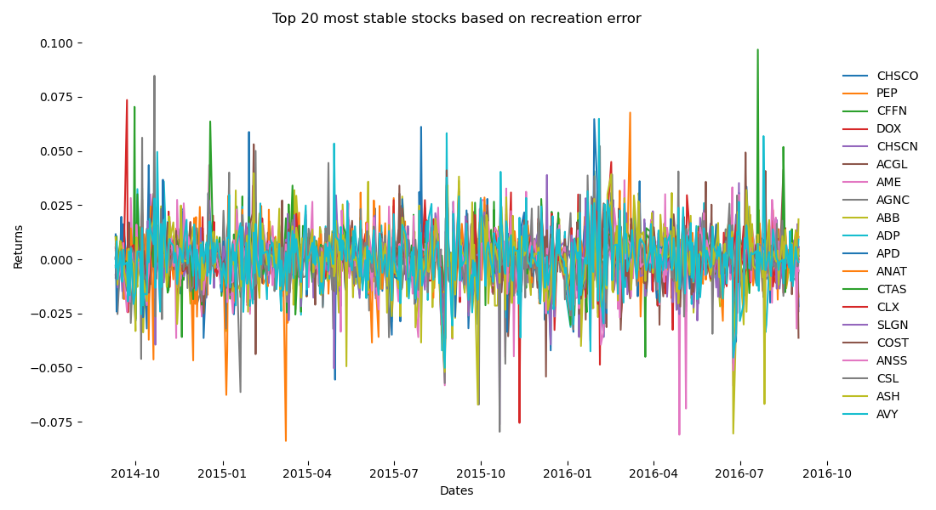
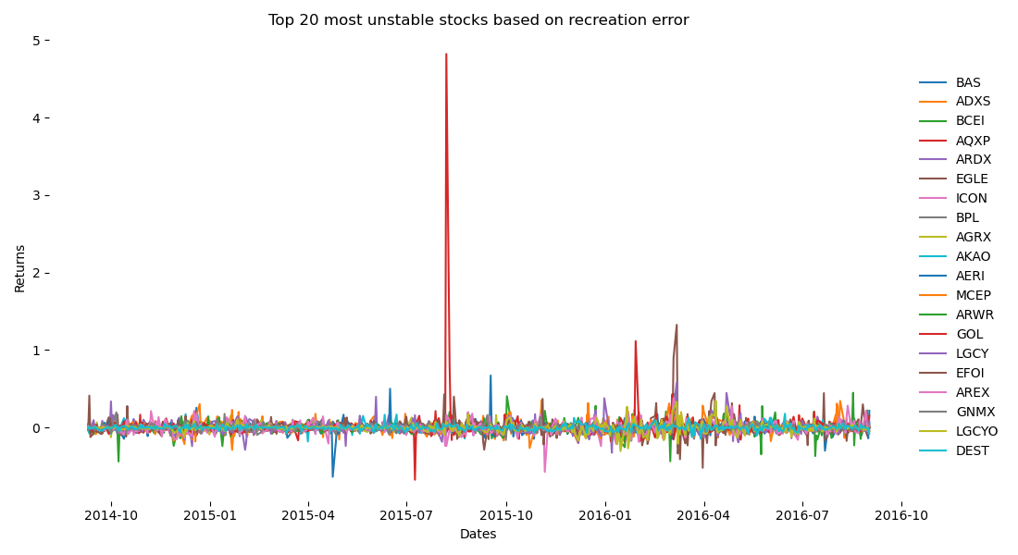
Which stocks to analyze?
1
Unstable stocks tend to be more volatile and have more unexpected spikes!
Top 20 most stable and most unstable stocks ranked by recreation error.

Slide 18
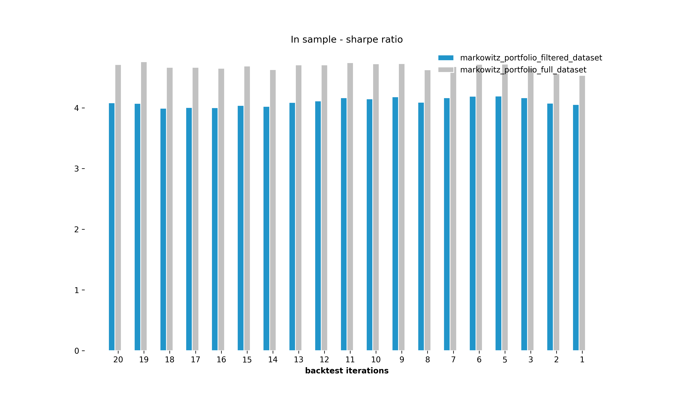
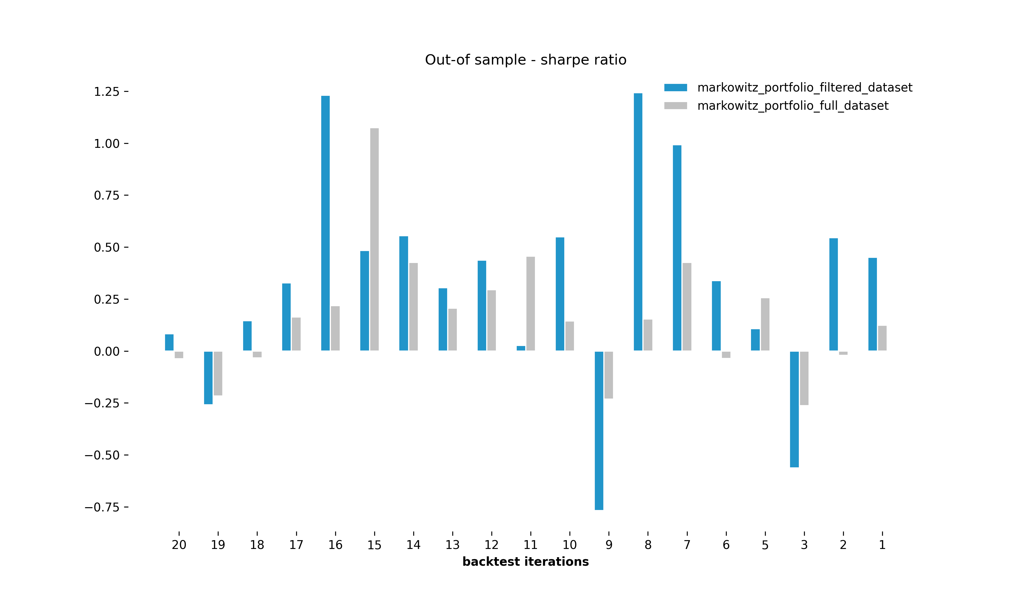
Which stocks to analyze?
1
Filtering based on recreation error improves out-of sample performance!
In-sample and out-of-sample sharpe ratio of models trained on full dataset and filtered dataset.
Notes:
13 out of 20 backtest show better out-of sample results!

Slide 19
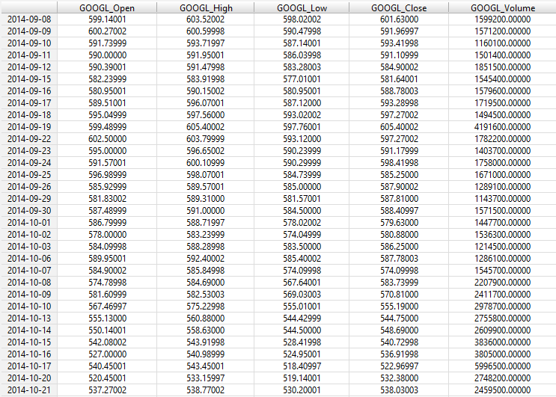
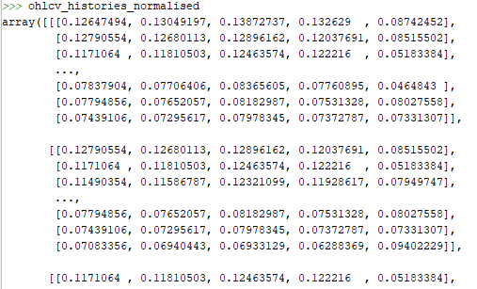
Does forecasting improve the portfolio?
2
Data transformation is still part of the job!
50 days sliding window
50 day sliding window example for RNN model.

Slide 20
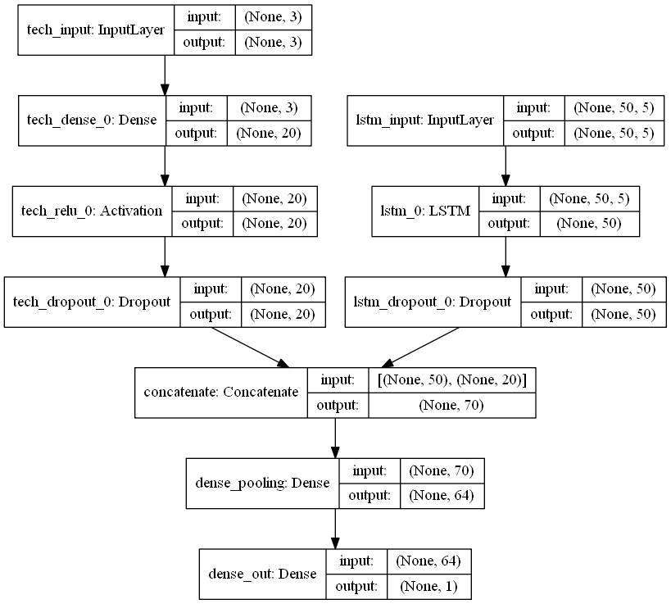
Does forecasting improve the portfolio?
2
Using a multi-input model is a good way to improve accuracy!
Model Design:
A multi-input model has been applied using Keras functional API, to include:
historic stock prices (ohlcv)
additional technical indicators e.g. exponential moving average
Keras RNN model.
Notes:
3 technical indicators
5 (ohlcv) input features
Sliding windows of 50 days
1-step forecast

Slide 21
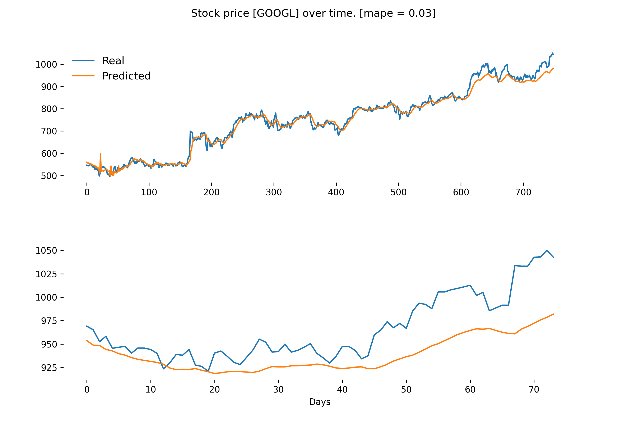
Does forecasting improve the portfolio?
2
Testing your model is still a must when doing forecasting!
Model Evaluation:
Model performance was measured using the mean absolute percentage error (MAPE).
A MAPE value of 0.03 implies that there is a deviation between actual and predicted values of 3%.
RNN model results fit on in-sample and out-of-sample dataset.

Slide 22
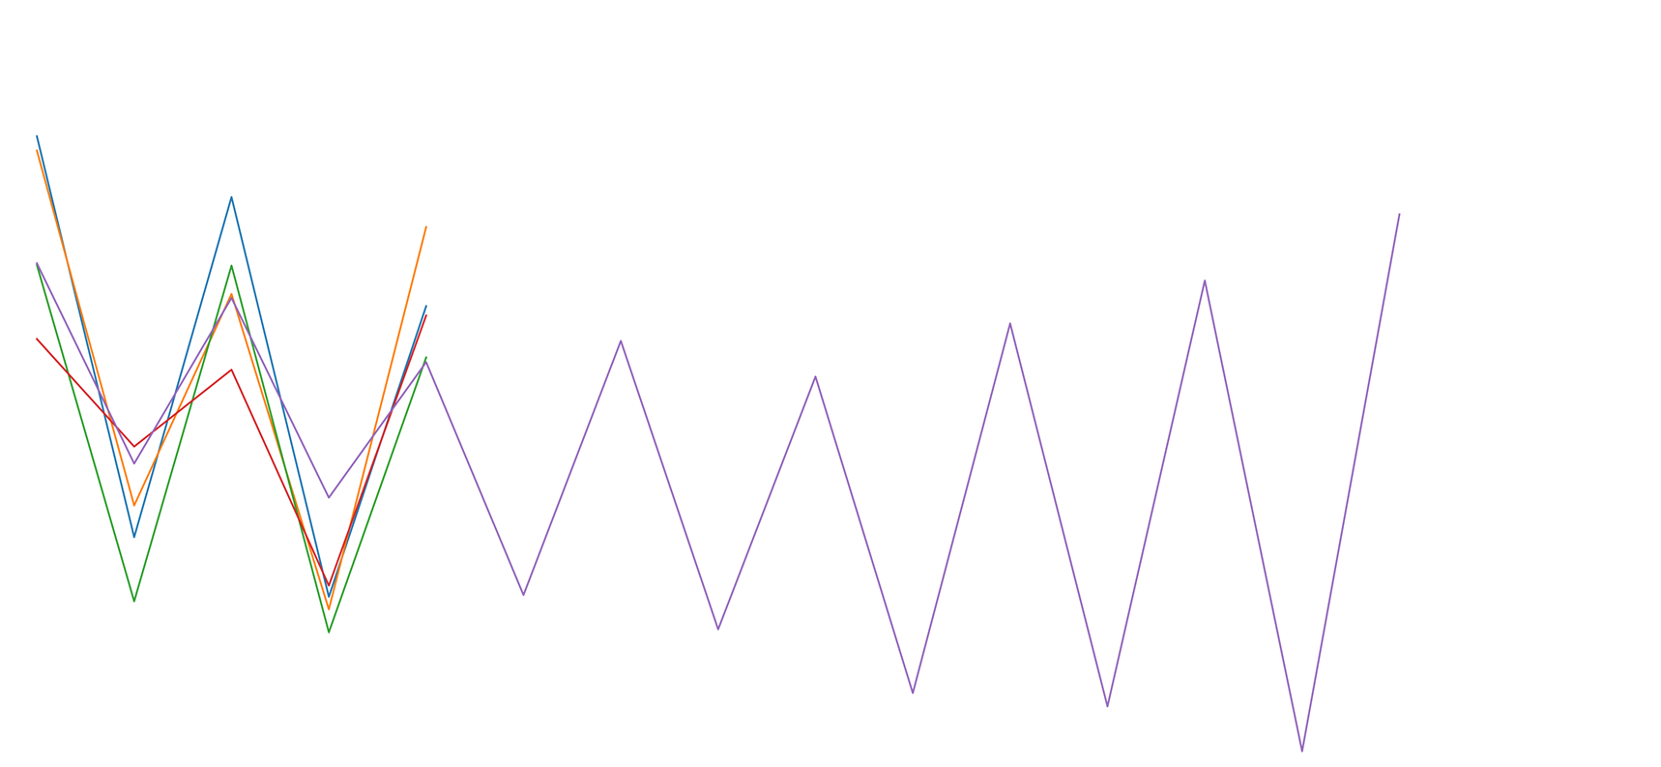
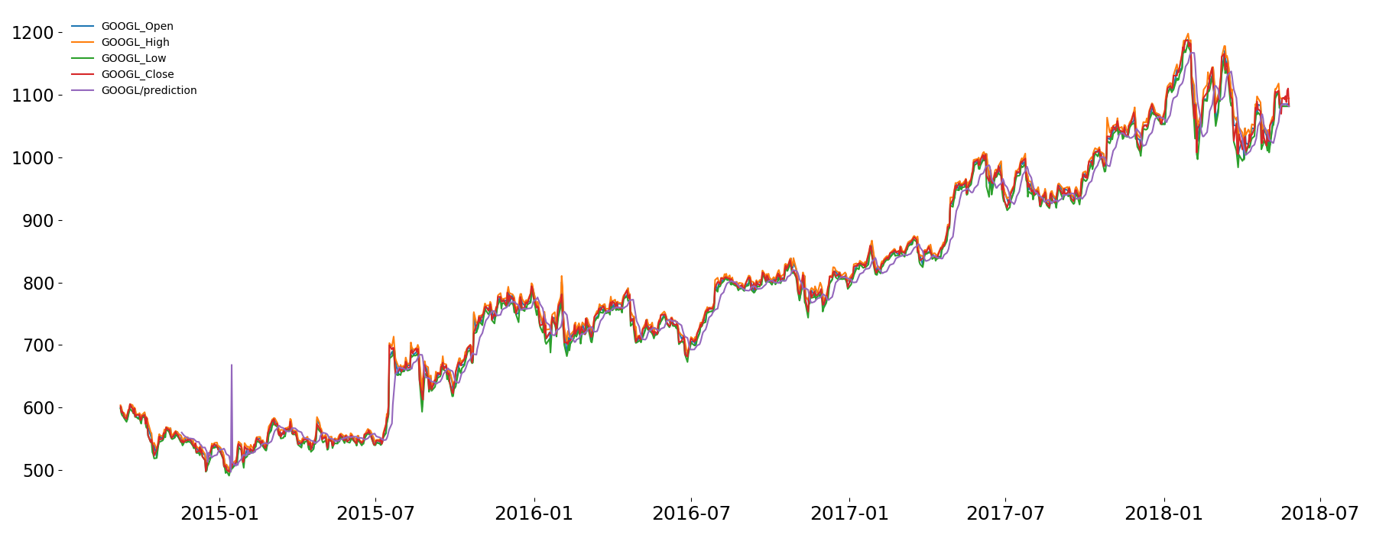
Does forecasting improve the portfolio?
2
RNNs do a great job at forecasting timeseries data!
RNN model results fit on entire dataset with 10-days out-of-sample forecast.
Notes:
In sample predictions look good
Out-of sample predictions get more noisy the farer we forecast!
Iterative one-step forecast are computationally expensive, but lead to better resuts!

Slide 23
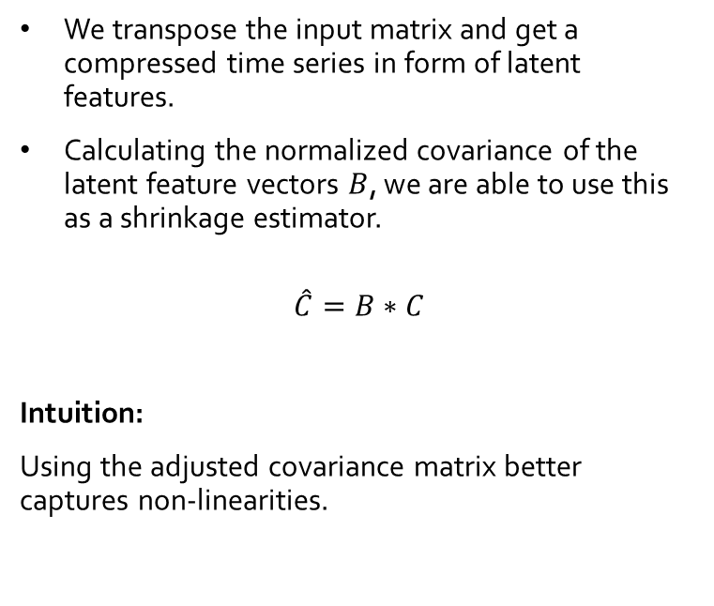
How to improve the risk calculation of a stock?
3
Latent features catch non-linearities and can be used to improve the sample covariance matrix!
Returns
We transpose the input matrix and get a compressed time series in form of latent features.
Calculating the normalized covariance of the latent feature vectors $B$, we are able to use this as a shrinkage estimator.
$$\hat{C}=B∗C$$
Intuition:
Using the adjusted covariance matrix better captures non-linearities.
Stocks
0.3
0.4
0.1
0.1
0.2
Input Cells
0.1
-2
0.3
Hidden Cells
Calculate normalized covariance matrix of latent features and multiply it with the original covariance matrix
Autoencoder model with calculated covariance of latent features.

Slide 24
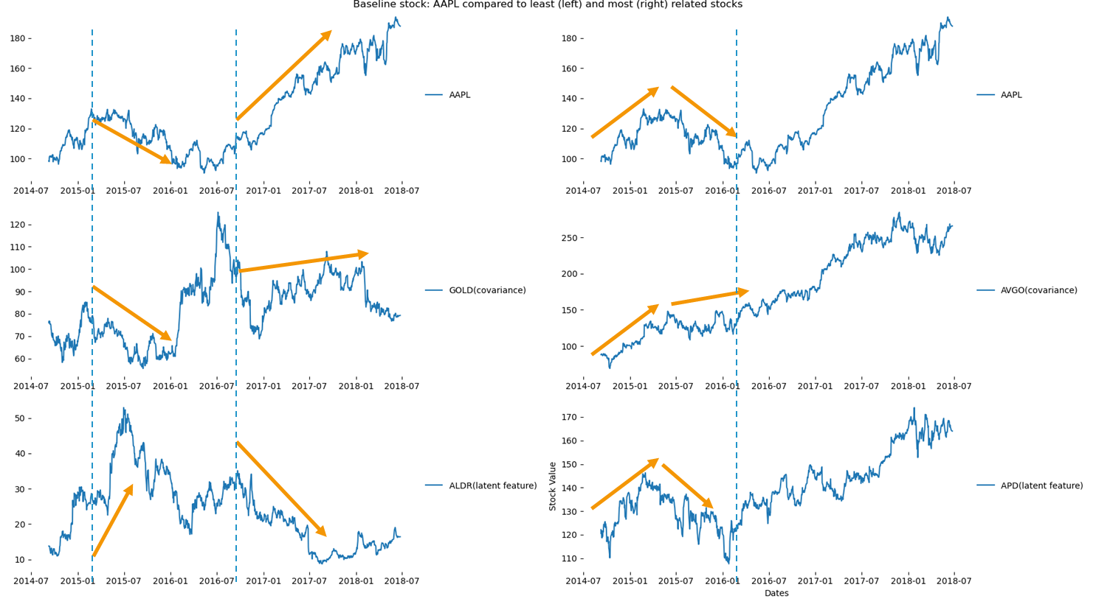
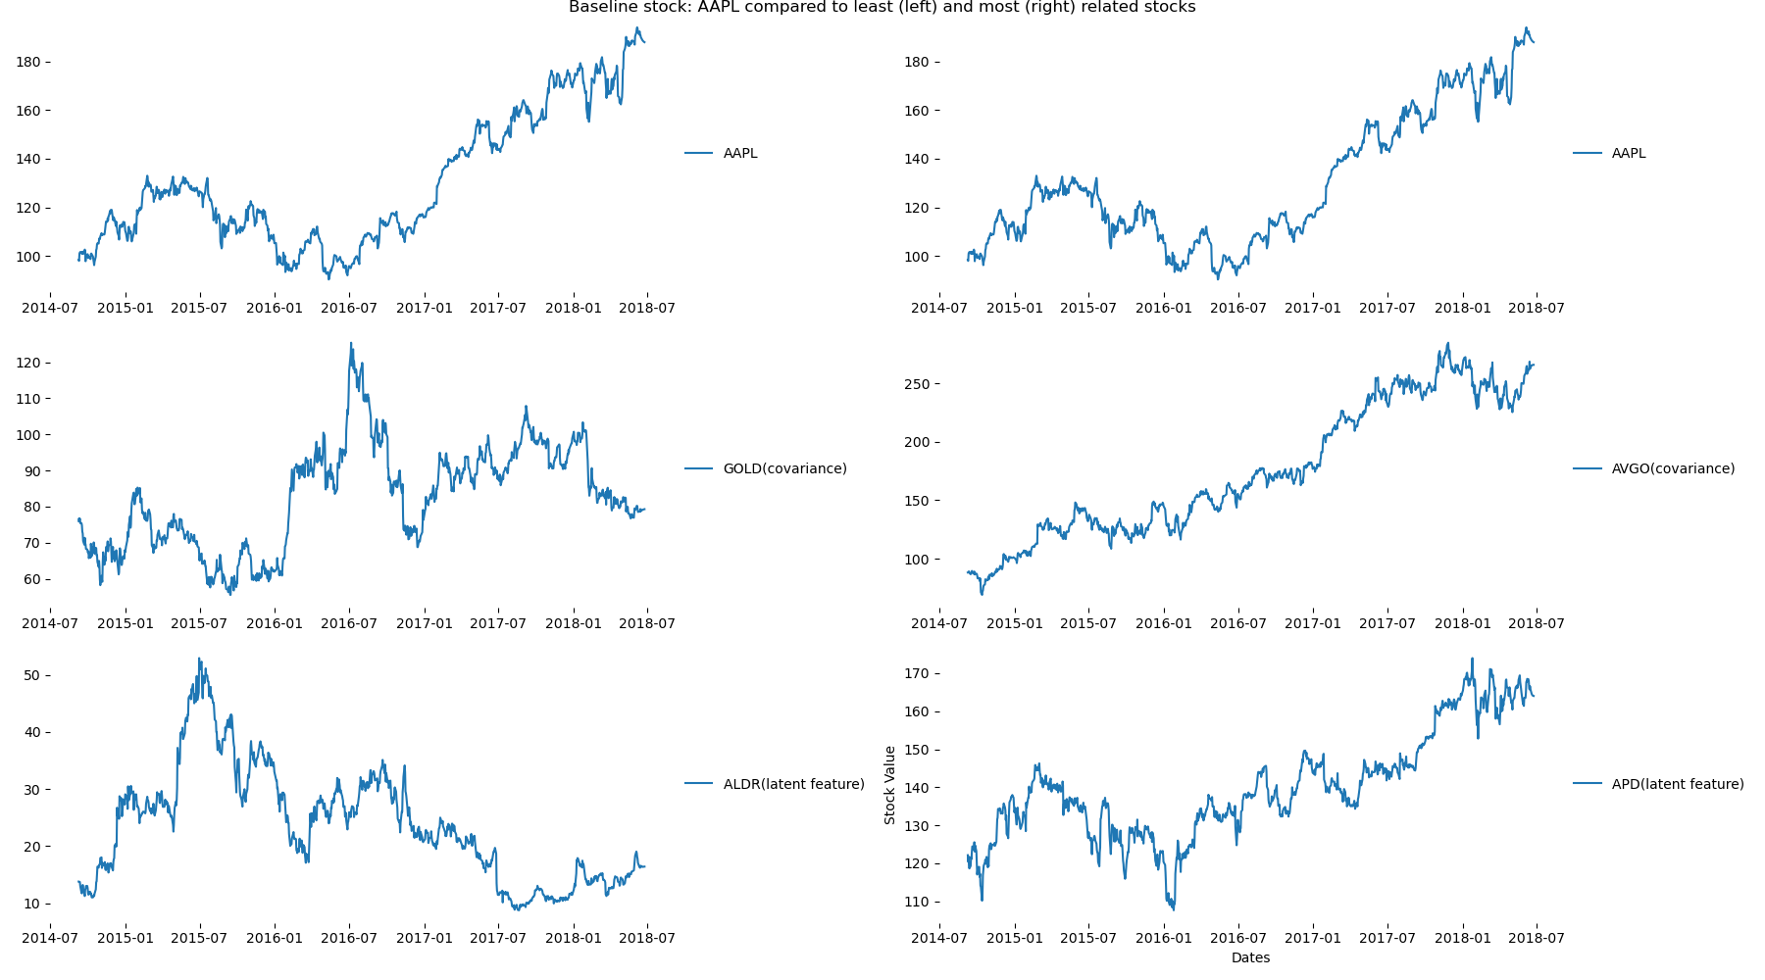
How to improve the risk calculation of a stock?
Can I calculate the risk of a stock? (Example ‘AAPL’)
3
Latent features catch non-linearities and can be used to improve the sample covariance matrix!
Baseline stock : APPL (Apple) compared to least (left) and most (right) related stocks
Notes:
Looking at the latent features, we see that the least related stocks move stronger in opposite directions
compared to stocks selected by the covariance calculation

Slide 25
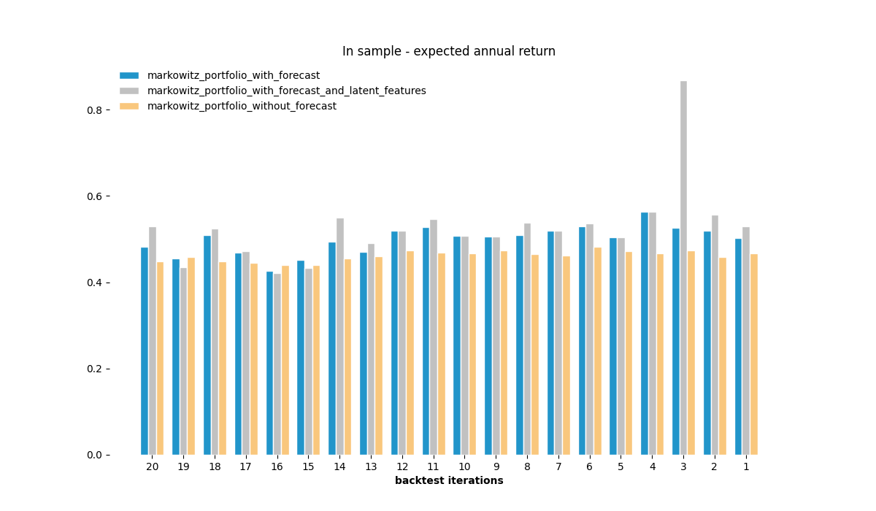
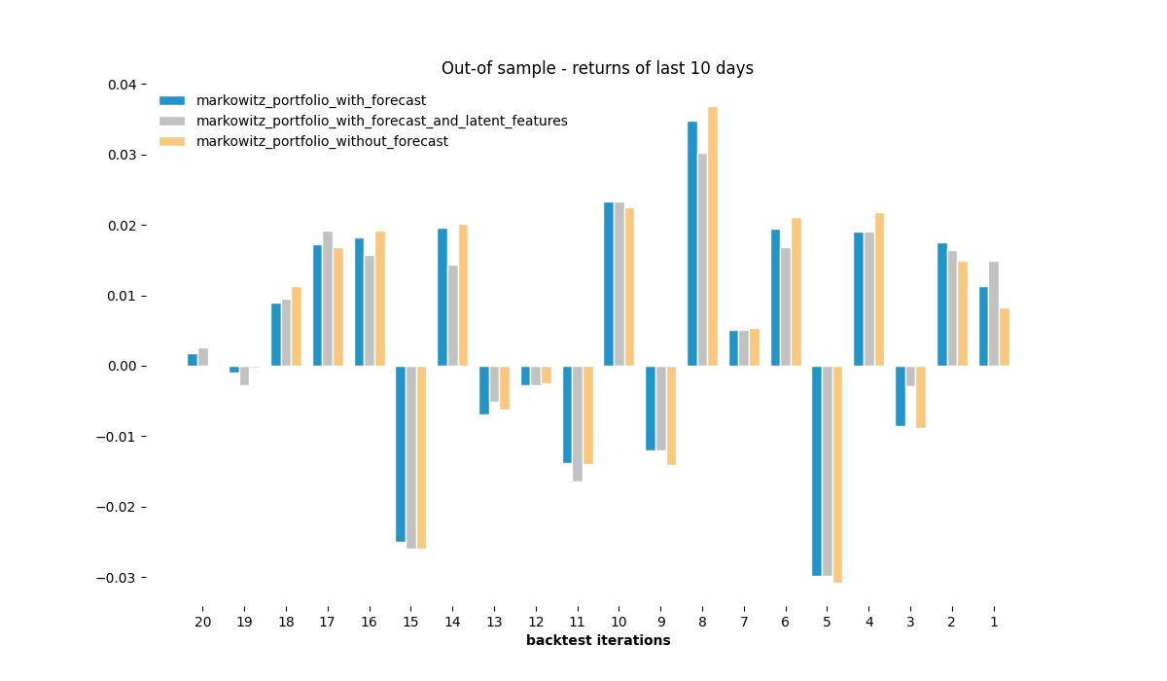
How to calculate an optimal portfolio?
4
In-Sample results look good, out-of sample results do not look indicative.
Expected annual return of Markowitz optimization using different input data (covariance matrix and returns)

Slide 26
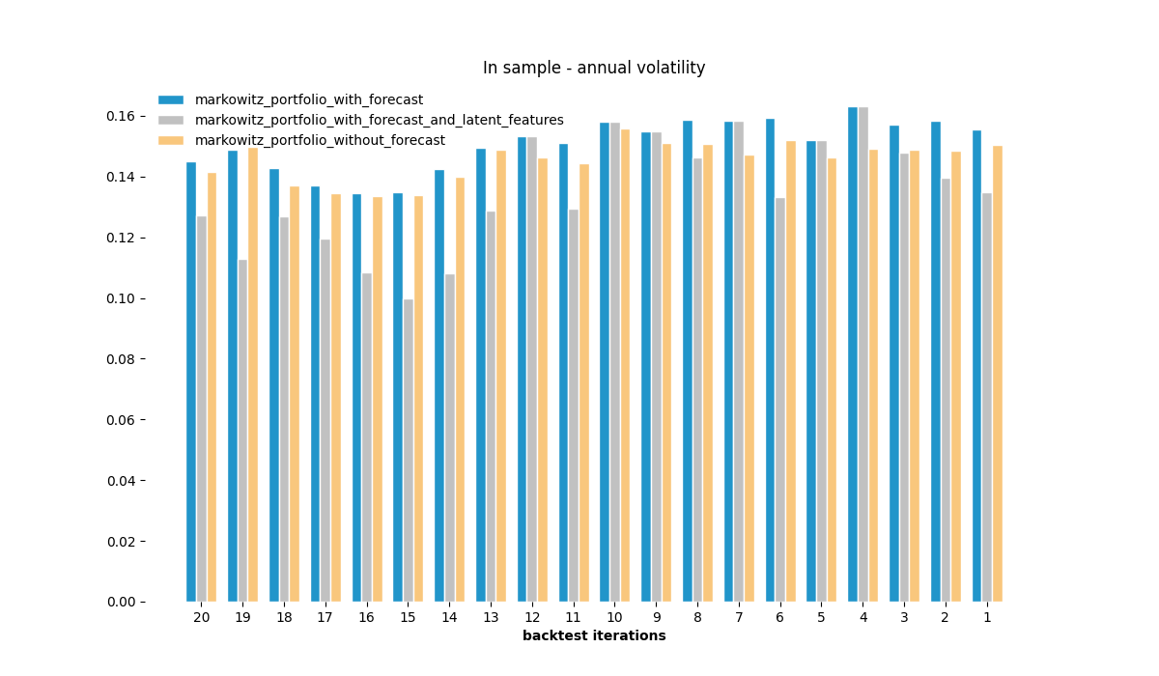
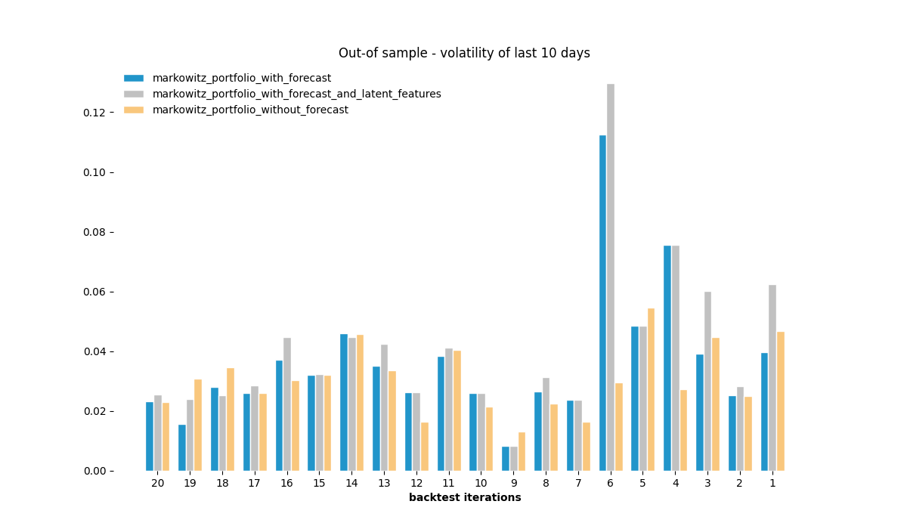
How to calculate an optimal portfolio?
4
Annual volatility of Markowitz optimization using different input data (covariance matrix and returns)

Slide 27
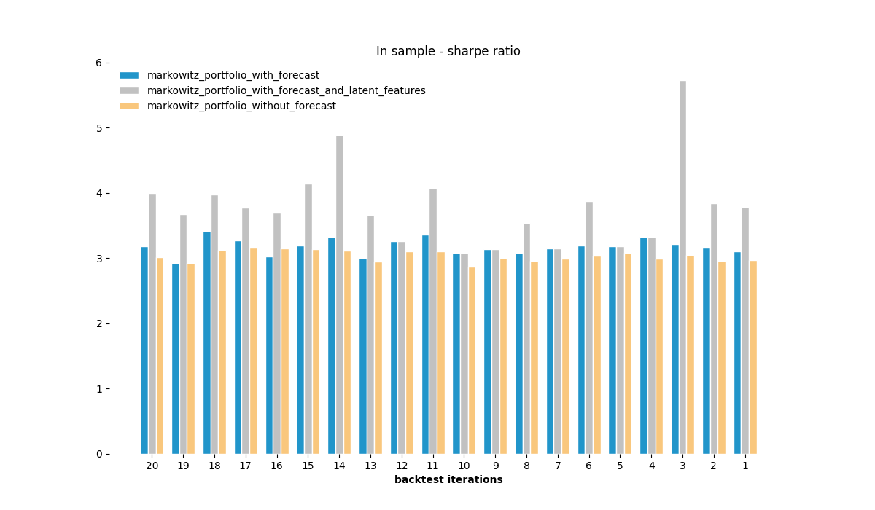
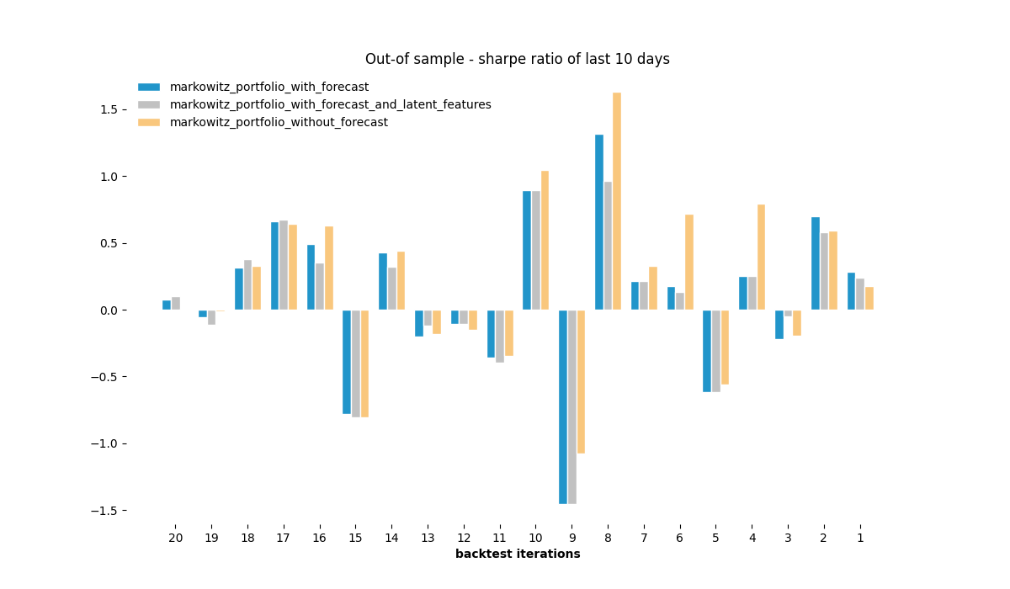
How to calculate an optimal portfolio?
4
Sharpe ratio of Markowitz optimization using different input data (covariance matrix and returns)

Slide 28
Conclusion and Future Research

Slide 29
Conclusion and Future Research
Which stocks to analyze?
→ Selecting stocks with the lowest reconstruction error improves calculation time and shows better out-of-sample results.
Does forecasting improve the portfolio?
→ Extending the dataset with a 10-day forecast leads to overall higher portfolio results.
How to improve the risk calculation of a stock?
→ Calculating the covariance of the latent features reduces annual portfolio volatility with similar or increased stock returns.
How to calculate an optimal portfolio?
→ The proposed model shows superior results on the in-sample dataset. The out-of-sample results may not be indicative.
1
2
3
4

Slide 30
References
J. B. Heaton, N. G. Polson, & J. H. Witte. (2016). Deep Portfolio Theory.
Werbos, P. (1990): Backpropagation Through Time: What It does and How to Do It. https://doi.org/10.1109/5.58337 Retrieved from http://axon.cs.byu.edu/~martinez/classes/678/Papers/Werbos_BPTT.pdf
https://towardsdatascience.com/getting-rich-quick-with-machine-learning-and-stock-market-predictions-696802da94fe
Olivier Ledoit & Michael Wolf, 2003. "Honey, I shrunk the sample covariance matrix," Economics Working Papers 691, Department of Economics and Business, Universitat Pompeu Fabra.

Slide 31
Q & A
Yes, my code is on github. https://github.com/QUER01/FinanceModule

Slide 32
How to calculate an optimal portfolio?
4
Some stocks are always selected, others only sometimes.

Slide 33
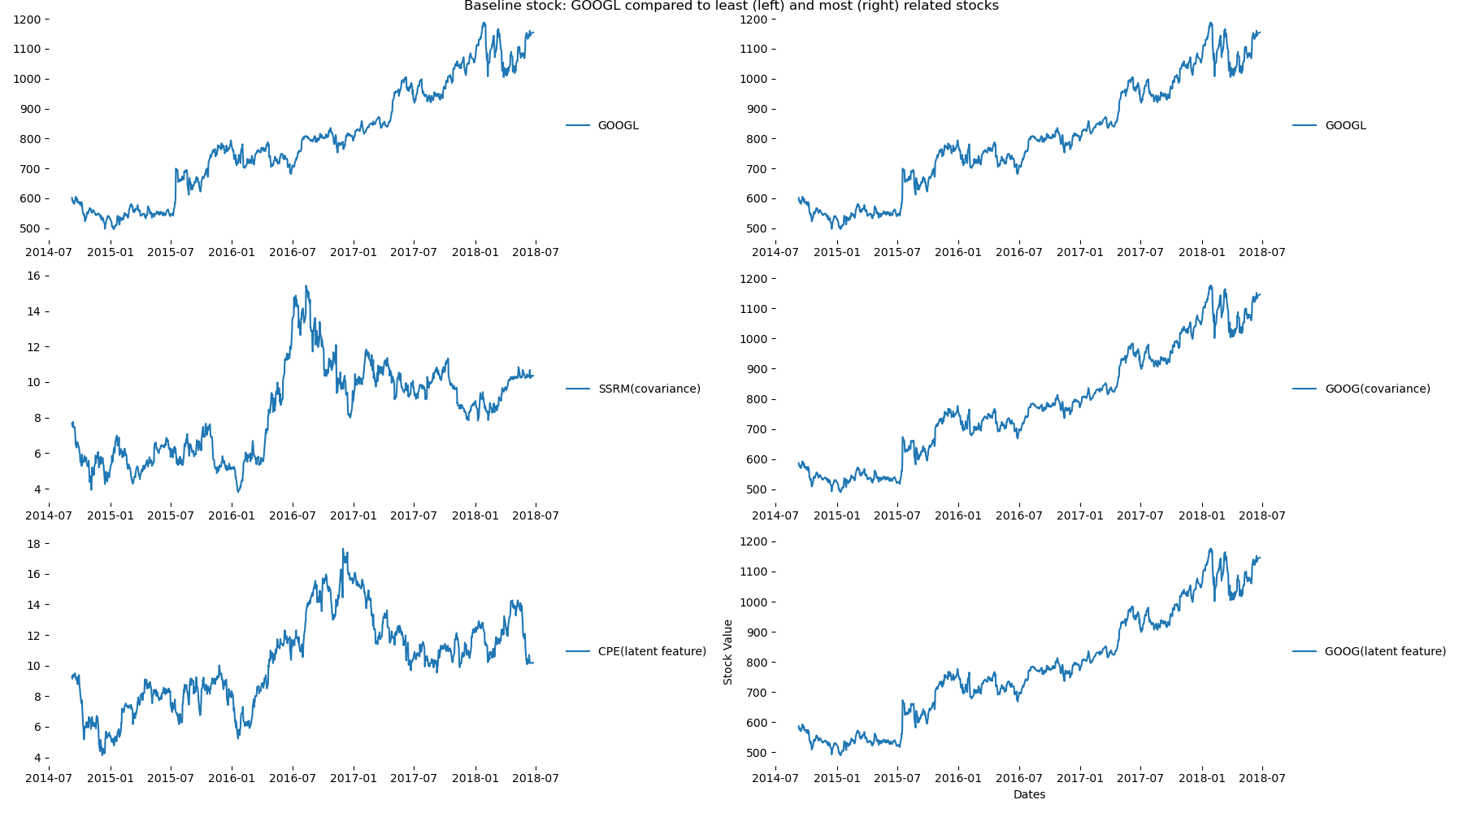
Data, Methodology & Results
3
Can I calculate the risk of a stock? (Example ‘GOOGL’)
Figure 18: Results (2) of latent features of autoencoder model.

Slide 34
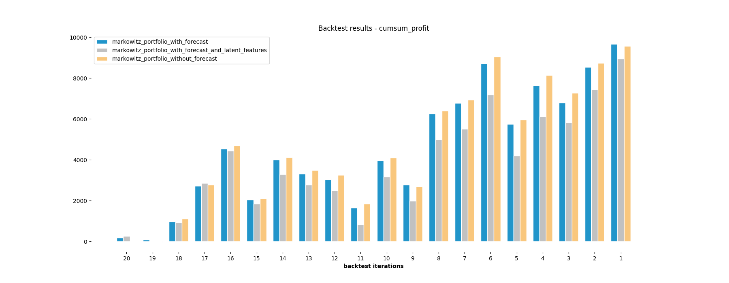
Data, Methodology & Results
4
Which stock should I put in my portfolio?

Slide 35
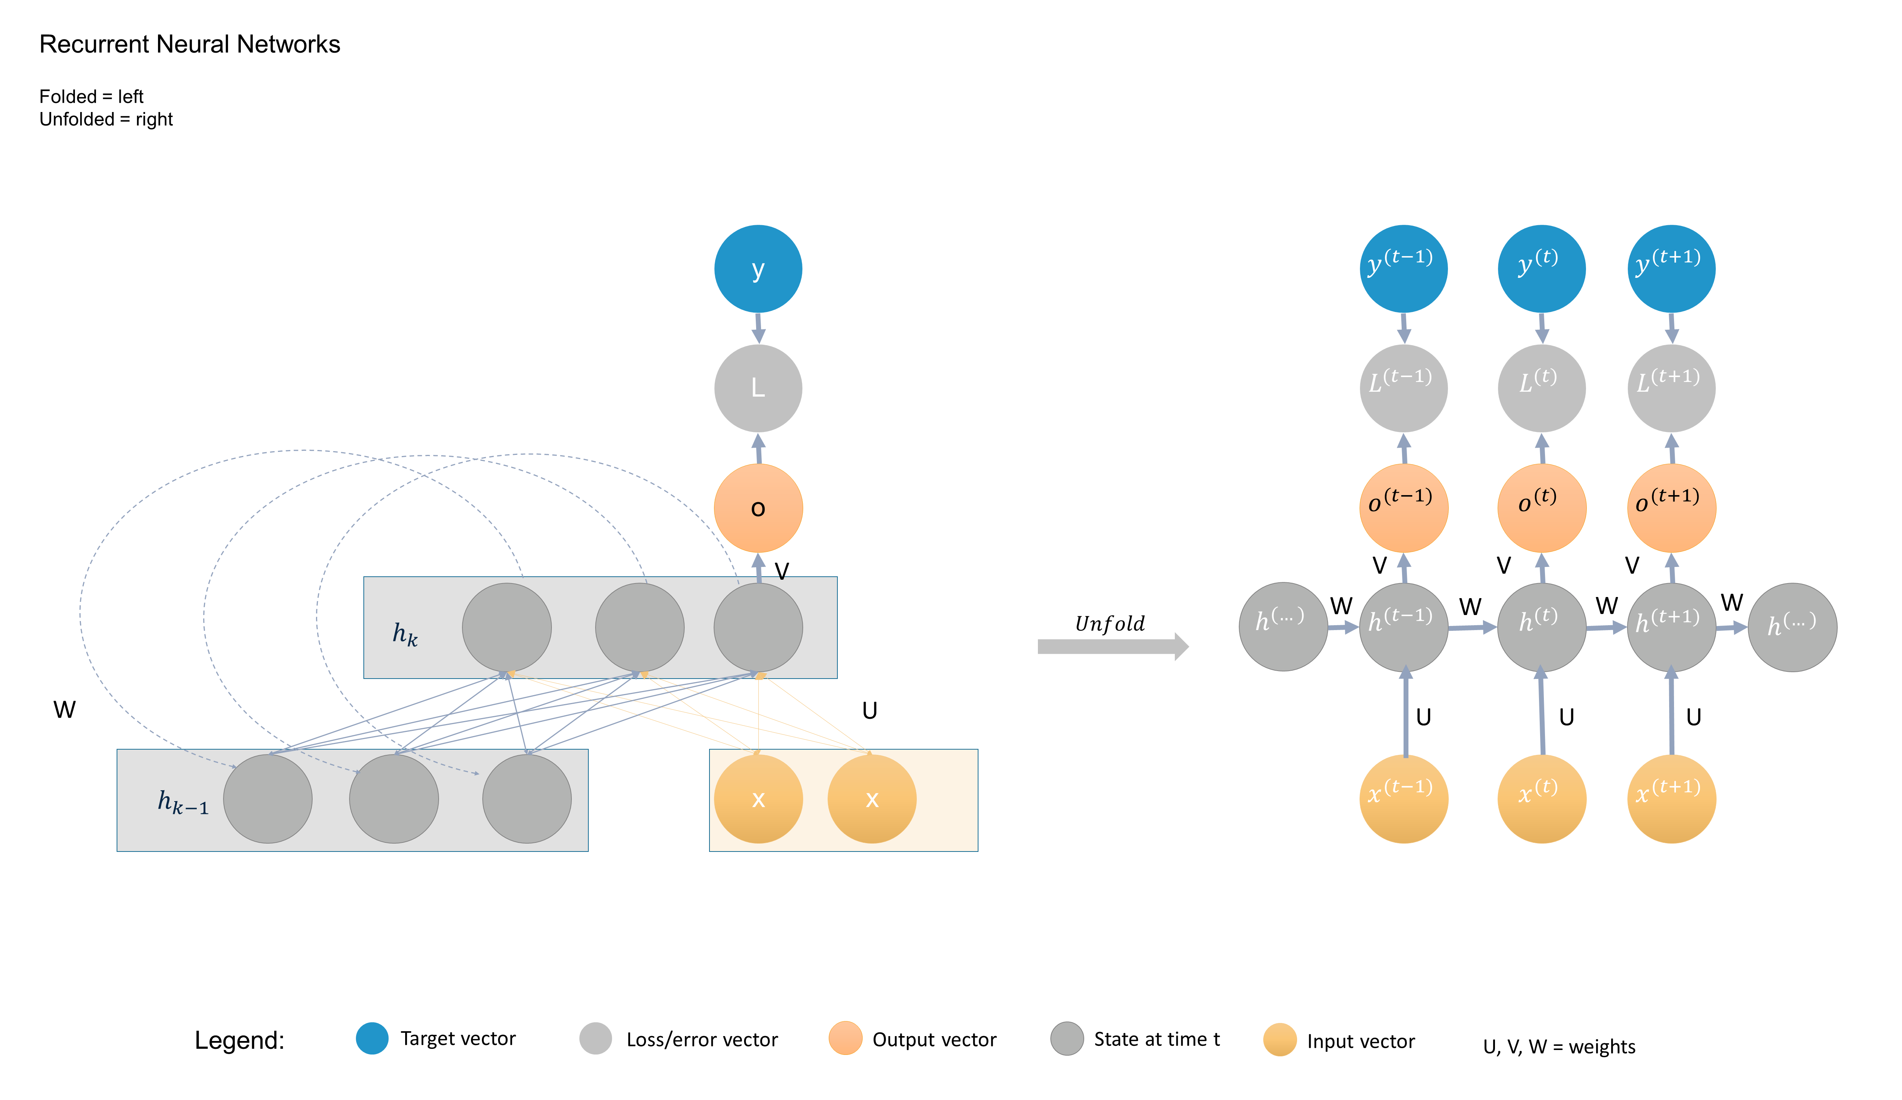
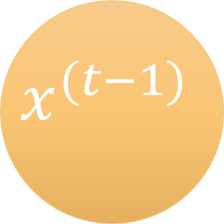
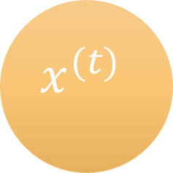
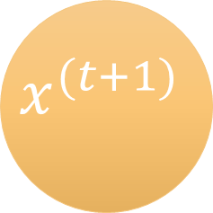
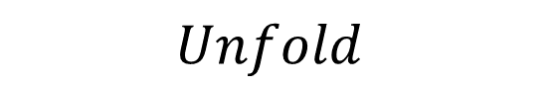
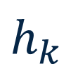
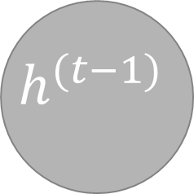
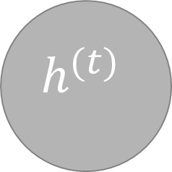
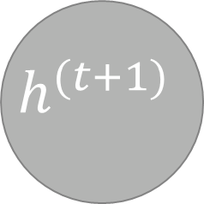
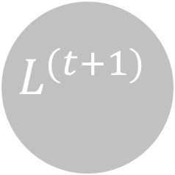











Recurrent Neural Networks
Folded = left
Unfolded = right
y
$$y^{(t−1)}$$
$$y^{(t)}$$
$$y^{(t+1)}$$
L
$$L^{(t−1)}$$
$$L^{(t)}$$
$$L^{(t+1)}$$
o
$$o^{(t−1)}$$
$$o^{(t)}$$
$$o^{(t+1)}$$
V
V
V
V
$$h^{(…)}$$
W
$$h^{(t−1)}$$
W
$$h^{(t)}$$
W
$$h^{(t+1)}$$
W
$$h^{(…)}$$
$$h_{k}$$
$$Unfold$$
W
U
U
U
U
x
x
$$x^{(t−1)}$$
$$x^{(t)}$$
$$x^{(t+1)}$$
$$h_{k−1}$$
Legend:
Target vector
Loss/error vector
Output vector
State at time t
Input vector
U, V, W = weights

Slide 36

Literature Review
Mathematical formulation of RNNs
The recurrent neuron $h^{(t)}$ is defined as:
$$h^{(t)}=f_{h}\left(U x^{\left(t\right)}+W h^{\left(t−1\right)}+b_{h}\right)$$
where:
$f_{h}$ is the activation function (e.g. sigmoid, tanh, ReLU)
$W, V and U$ are weight matrices
$b_{h}$is a bias term
$x^{\left(t\right)}$ is the current input
$h^{\left(t−1\right)}$ is the prior state
Training an RNN is only possible with Backward Propagation Through Time (BPTT), which in some cases can lead to the vanishing or exploding gradient problem.
(1)
Figure 5: An example of a folded and unfolded RNN.

Slide 37









Literature Review
Variational Autoencoder
Generative Models: Variational Autoencoder (VAE)
A variational autoencoder [Bayer and Osendorfer, 2015] adds a constraint to the encoder function forcing it to generate a latent vector 𝒛 that follows a gaussian distribution (mean and standard deviation vector).
VAE minimizes the reconstruction loss as well as the latent loss.
Hence, rather than building an encoder that outputs a signal value for each component $z_{i}$ of $z$, the VAR model generates an encoder that describes the probability distribution for each $z_{i}$.
This probability distribution might yield better results in anomaly detection than the deterministic reconstruction error of classic autoencoder methods. [An and Cho, 2015]
Figure: Example of a variational autoencoder with three input and output layers and two hidden layers.
Probabilistic Encoder
$$Sampled Latent Vector$$
$$Probabilistic Decoder$$
x
$$μ$$
$$z$$
$$x^{′}$$
Input Vector
Output Vector
Mean Vector
$$σ^{2}$$
$${σ^{2} ⨀ε }^{2}$$
Variance Vector
Error Vector
Sampled Vector
$$ε$$

Slide 38

Which stocks to analyze?
1
There are many ways to Rome. Try not to overfit, even when the results look prettier!
Model Design:
ReLU activation function was used to guarantee fast convergence
A dropout layer is used, which esentially makes this model a denoising autoencoder, with the goal of producing a network that is more robust to noise.
Figure 11: Keras Autoencoder model.

Slide 39
Agenda
Introduction
Literature Review
Data and Methodology
Results

Slide 40
Introduction
Research Questions
Research Question 1:
Research Question 2:
Can we predict the stock price of the next few days using recurrent neural networks?
Can we construct an investment portfolio using Deep Portfolio Theory (Heaton et.al, 2018) that incoprerates
stock forecasting results,
stock returns,
diversified risk

Slide 41

Data, Methodology & Results
3
Can I calculate the risk of a stock?

Slide 42
Which stocks should I analyze?
Can I predict the value of a stock?
Can I calculate the risk of a stock?
Which stock should I put in my portfolio?
“Only the clairvoyant could hope to predict with certainty.”
– Harry M. Markowitz, Nobel price winner in Economics
“Prediction is very difficult, especially if it’s about the future.”
– Nils Bohr, Nobel laureate in Physics

Slide 43
Data, Methodology & Results
Which stocks should I analyze?
Can I predict the value of a stock?
Can I calculate the risk of a stock?
Which stock should I put in my portfolio?
1
2
3
4

Slide 44
Data, Methodology & Results
3
Can I calculate the risk of a stock?
Model Design:
The model starts with the encoder, which samples from a gaussian distribution and creates the vector z..
The decoder then recinstructs the input sequence from z.
Other paramteres are equivalent to the first autoencoder model
Training Optimization parameters:
500 epochs per model training
Adam Optimizer was used
Mean Squared Error as loss function

Slide 45


















Literature Review
$$t_{1}$$
Convert Time Series to supervised learning problem
$$t_{1}$$
$$t_{2}$$
$$t_{1}$$
$$t_{2}$$
$$t_{3}$$
$$t_{1}$$
$$t_{2}$$
$$t_{3}$$
$$t_{4}$$
$$t_{1}$$
$$t_{1}$$
$$t_{2}$$
$$t_{3}$$
$$t_{4}$$
$$t_{5}$$
$$t_{2}$$
$$t_{2}$$
$$t_{3}$$
$$t_{4}$$
$$t_{5}$$
$$t_{6}$$
$$t_{3}$$
$$t_{3}$$
$$t_{4}$$
$$t_{5}$$
$$t_{6}$$
Sliding windows
$$t_{4}$$
$$t_{4}$$
$$t_{5}$$
$$t_{6}$$
$$t_{5}$$
$$t_{5}$$
$$t_{6}$$
$$t_{6}$$
$$t_{6}$$

Slide 46

Literature Review
How to train an RNN?
The objective of the BPTT algorithm [Werbos, 1990] is to update the weight matrix $W$ at any timepoint $t$ to minimize the global loss $L$, defined by the sum of the loss functions $L^{(t)}$
$$L=\sum_{t=1}^{T}{L^{(t)}}$$
The gradient of the global loss is then defined by
$$\frac{∂L}{∂W}=\sum_{t=1}^{T}{\frac{∂L^{(t)}}{∂W}}$$
Applying the chain rule and some substitutions we obtain
$\frac{∂L}{∂W}=\sum_{t=1}^{T}{\sum_{k=1}^{t}{ \frac{∂L^{(t)}}{∂o^{(t)}} }\frac{∂o^{(t)}}{∂h^{(t)}} \frac{∂h^{(t)}}{∂h^{(k)}} \frac{∂h^{(k)}}{∂W}}$
(2)
(3)
(4)

Slide 47

Literature Review
What are Autoencoders?
An autoencoder is an unsupervised neural network that is trained to attempt to copy its input to its output [Goodfellow et al., 2016].
Autoencoders are used for:
dimensionality reduction
removing structural noise
feature learning
outlier detection
Autoencoders are also applied in combination with recurrent neural networks (RNN) on timeseries data (e.g. (Bao et al., 2017)).
Figure: Example of an undercomplete autoencoder with three input and output layers and two hidden layers.
Encoder
$$Hidden Vector$$
$$Decoder$$
x
z
$$x^{′}$$
Input Vector
Hidden Vector
Output Vector

Slide 48

Literature Review
Mathematical formulation of Autoencoders
$$x$$
z
$$\acute{x}$$
An autoencoder may be viewed as consisting of two parts:
Encoder function: $f\left(x\right)=z ∈ℝ^{D}$
Decoder function: $g\left(z\right)=\acute{x}∈$ $ℝ^{D}$
Both functions are of the form $y= σ\left(Wy+b\right)$ where $σ$ is an activation function, $W$ is a weight matrix and $b$ is the bias.
The hidden layer $z$ describes a code that is used to represent the input.
During the learning process, the autoencoder adjusts the values of the latent variables $z$ through minimizing the reconstruction error/loss function:
$L(x, g(f\left(x \right))$) (1)
Input Cells
Hidden Cells
Output Cells
$$x$$
$$Encoding$$
$$Decoding$$
Figure: Example of an undercomplete autoencoder with three input and output layers and two hidden layers.

Slide 49

Literature Review
Mathematical formulation of Autoencoders
$$x$$
z
$$\acute{x}$$
The encoder stage maps the encoder vector to the decoder stage by identifying the latent variables $z$.
$z= σ(Wx+b)$ (2)
The decoder stage maps the latent variables $z$ to the decoder result $\acute{x}$.
$\acute{x}= \acute{σ} (\acute{W}z+\acute{b})$ (3)
By making $\acute{x}$ a function of $x$ (substitute (2) in (3)) and subtracting it from the input vector $x$ , we can minimize the reconstruction error by calculating
$∥x− \acute{x}∥^{2}=∥x− \acute{σ} (\acute{W} (σ\left(Wx+b\right))+\acute{b})∥^{2}$ (4)
Input Cells
Hidden Cells
Output Cells
$$x$$
$$Encoding$$
$$Decoding$$
Figure: Example of an undercomplete autoencoder with three input and output layers and two hidden layers.

Slide 50
Literature Review
How does backtesting work?
Split the data into training data and test data
Build a model based on the training data
Use the model to forecast for the test data period
Compare between forecasted and actual values
Data
Train Set 1
Test Set 1
Train Set 2
Test Set 2
Train Set 3
Test Set 3
Train Set 4
Test Set 4
Time

Slide 51

Data, Methodology & Results
1
Which stocks should I analyze?

Slide 52

Data, Methodology & Results
2
Can I predict the value of a stock?

Slide 53

Data, Methodology & Results
3
Can I calculate the risk of a stock?
Model Design:
We consider a similar Autoencoder Model as described before, whereas we now feed it with the transposed dataset.
Only the Encoder model is used and the hidden features values extracted.

Slide 54



Data, Methodology & Results
3
Can I calculate the risk of a stock?
…

Slide 55

Data, Methodology & Results
4
Which stock should I put in my portfolio?

